Slide 1
Obesity in Children
(Causes, trends and effects)
Ramya S N

Slide 2
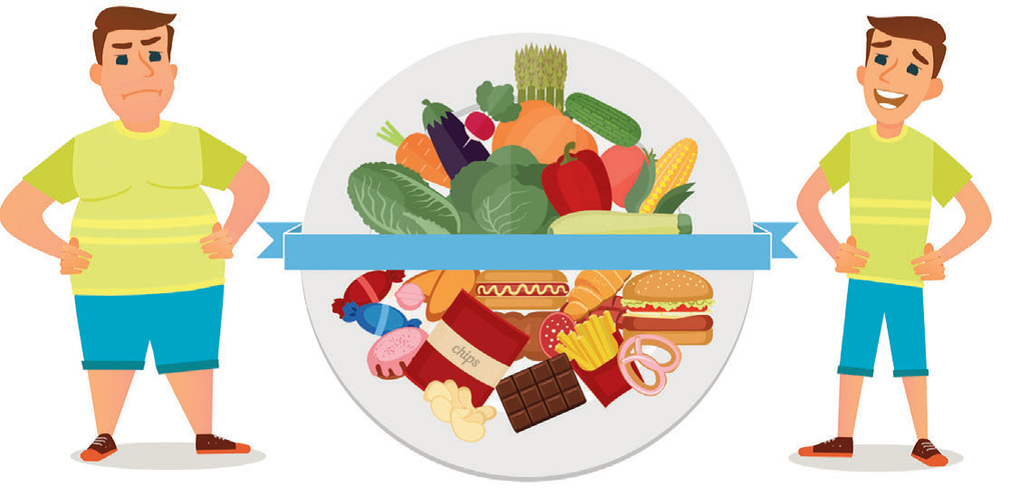
Why worry about Obesity?
United Nations has declared 2016-25 as “UN Decade of Action on Nutrition”
Nutrition in Kids has been a cause of concern over the last decade
Malnutrition and Obesity are connected to each other in a strange way
While developing countries are facing a severe case of malnutrition in children, developed nations like the US are facing a different kind of Malnutrition issue/Obesity

Slide 3
Obesity rate over the years in US
Between 1980 – 2000, childhood obesity increased 3 times
Sudden spike can be linked to the change in food habits along with lifestyle changes.
Increase in time spent in front of TV(from 2 hrs to 5 hrs), easy mode of transportation (cycles-walk), less physical activity(video games-outdoor games) are few of the other reasons
[1]
[1] From 1971 – 99, the data available is not consistent. After 99, the data is collected for every two years and cumulative rate is analysed.
[2] 2003-04 shows maximum increase in the obese rate
[3] The data used for this analysis calculated the percent of obese in the age group of 2-19 years over the span of two years and displayed the sum of this percentage.

Slide 4

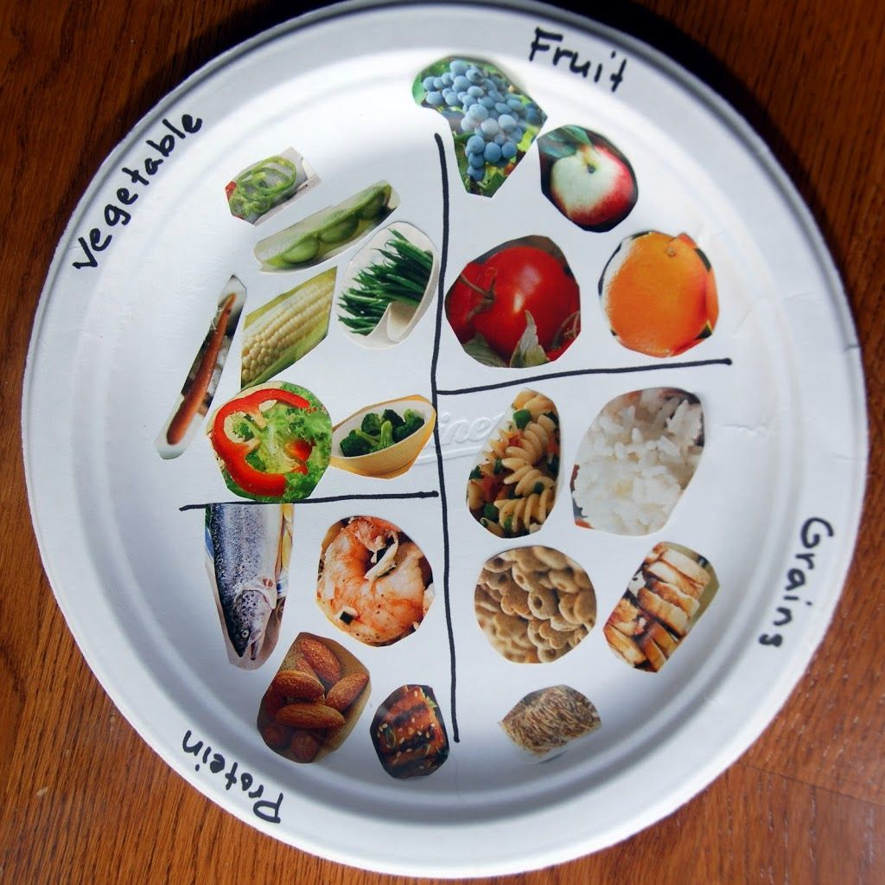
How Malnutrition and Obesity are related?
Children often follow parents food habits. Healthy eating = healthy living
With fast food culture being the quick and delicious way to fill the stomach, children eat more fat and less of vitamins and minerals.
BMI and weight loss aren’t the only indicators of malnutrition
Lack of micro-nutrients(vitamins and minerals) is the main cause of malnutrition amongst obese kids
A study says 60% of the obese people suffer from malnutrition.

Slide 5
Who is responsible for this?
At first thought, everybody blames the fast food restaurants and junk food manufactures, though they are also partly responsible.
A survey was conducted asking Americans who they thought is responsible for the increase in epidemic.
94% of people believed each individual is responsible. With 91% of people saying parents were responsible; indicates the alarming rate at which children are becoming obese.
The US CDC has also declared Obesity as a National epidemic.

